Slide 1


AgentX
LLM Agents MOOC Competition
May 2025

Slide 2

AgentX: LLM Agents for Intelligent Requirements & Test Case Automation
Agents for Customer Requirements, System Requirements, System Testcases and Customer Testcases

Slide 3
From Chaos to Clarity – The Core Problem in Engineering Today
Engineering teams waste 3–4 months turning unstructured input into system requirements and test cases — only for 70% to be reworked.
❌ Manual reviews, low traceability, no reuse
❌ No IREB/ASPICE automation
❌ Zero integration with DevOps or GitOps pipelines
❌ No feedback learning from user edits
🎯 Problem: Broken workflows are bottlenecks in safety-critical SDV development.

Slide 4
25 Engineers. 4 Months. 70% Errors. Every Release.
🚨 The Real Cost of Manual Engineering
Before AgentX
25 engineers manually decode input
4 months to write specs/test cases
70% errors found in reviews
0% reuse across similar projects
After AgentX ✅ Upload → Generate → Judge → Deploy ✅ 80% faster, 92% IREB-compliance ✅ Deployed in OEM pilot teams
🧠 AgentX = not just AI — it's a new way to engineer.

Slide 5
Where It Hurts — Manual Methods Are Failing
Activity | Timeframe | Pain Point
Customer Req → Sys. Req | 4–6 weeks | Manual parsing, inconsistent formats
Sys. Req → Testcase Mapping | 2–4 weeks | No automation, poor traceability
Compliance Review | 2–3 weeks | Manual checklists, no live feedback
Edit Impact on Quality | — | No change tracking
Team Alignment | Weeks | Excel/email chaos, fragmented tools

Slide 6
Who Needs AgentX — And Why Now?
🎯 Personas & Needs
System Engineers: Structured, editable outputs
QA Leads: Auto-generated, traceable test cases
PMs: Visibility + compliance confidence
Regulators: Audit-ready exports
📈 Market Opportunity
TAM: $50B+
SAM: $12B
SOM: $500M AI Req/Test beachhead
⚠️ Why Now?
SDVs are mainstream
Compliance overhead is exploding
GenAI + GitOps = perfect storm

Slide 7
Proof of Demand —
OEMs and Tier-1s Are Already Asking for It
📊 What We have Captured:
4 OEM and Tier-1 pilot LOIs secured
78% engineers want AI-assisted workflows
Git-native outputs requested in pilot interviews
70% manual effort reduction in sandbox trials

Slide 8
Introducing AgentX —
A Purpose-Built Multi-Agent System
💡 AgentX transforms chaos into validated output:
🧠 Capabilities:
Generate Sys.1–Sys.2
Auto-generate Sys.5 test cases
Judge for IREB/UAT compliance
Self-improve through memory
Native GitOps + Jira integration

Slide 9
What AgentX Looks Like in Action
🖼 Flow Summary:
Upload input (PDFs, Jira XML)
Planner segments content
Generator proposes requirements
Judge scores and flags
Memory learns from edits
GitOps export
📍 Real demo validated by 3 OEMs

Slide 10
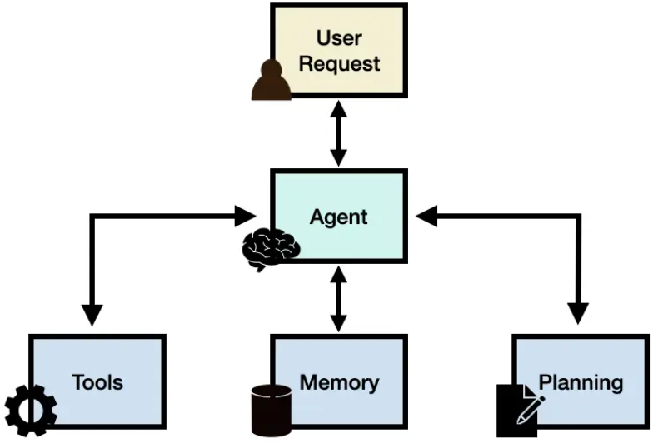
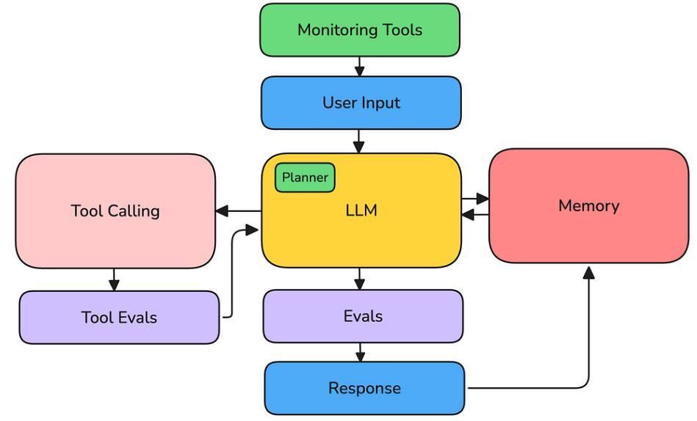
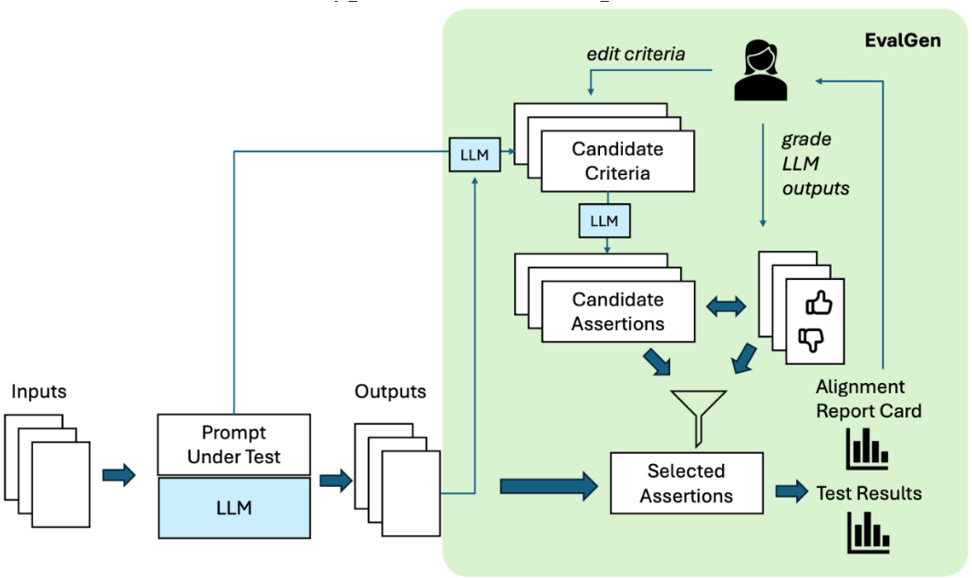
Agent Architecture —
A Loop That Improves Itself
Input → Planner → Generator → Judge → Memory → Output ↘ Feedback Loop ↙
Role-specific prompts
In-memory semantic recall
Git-native + CI/CD ready
Supports Hugging Face or BYOM

Slide 11
Competitive Landscape —
Why AgentX Is Unique
Feature | Legacy Tools | AgentX
AI-Generated Output | ❌ | ✅
IREB/UAT Compliance | ❌ | ✅
GitOps Integration | ❌ | ✅
Quality Gating | ❌ | ✅
Learning Memory | ❌ | ✅
AgentX leads in automation, compliance, and judgment.

Slide 12
Go-To-Market Strategy — From Pilots to Scale
OEM Direct Pilots
Community GitHub + Hugging Face
Domain Expansion (Auto → Aero → Health)
Channel Partners (ALM/MBSE Integrators)
Thought Leadership Content

Slide 13
Revenue Model — Tiered with Add-Ons
Tier | Offering | Price
Starter | 4 Agents, SaaS | $99K/year
Growth | Full VPC, compliance checks | $250–300K
Enterprise | On-prem, fine-tuned | $400–600K
Custom | BYOM, Air-gapped, defense | $600K+
🔌 Add-ons: HF fine-tune, SDKs, SOC2 Toolkit

Slide 14
Funding Ask — Built for Expansion
💰 $5M for 10% equity
📈 Preferred rights for follow-on $5M
🔧 Usage:
40% Team
25% Sales/GTM
20% Infra/LLMs
15% Chatbot + Tuning

Slide 15
GTM Traction + Execution Path to $10M+
Phase | Channel | CAC | Conv. | Revenue
Pilot | Direct OEMs | $2K | 25% | $300K
Open | GitHub/HF | $50 | 8% | $600K
Scale | Webinars/Partners | $500 | 18% | $1.2M
✅ LOIs signed
✅ GitOps-native = easy onboarding
✅ White-label ready for ALM ecosystem

Slide 16
Team — Experts in AI, GTM, and SDVs
👥 Core Members:
Mohinder Pandey – Product (SDV/MBSE)
Ranjit Jagtap – LLM Architect
Chaitanya Kulkarni – DevOps, ALM
Deepak Garg – GTM & Tier-1
🎓 Advisors: OEM CTOs, Safety Auditors, GenAI researchers

Slide 17
Summary — Why AgentX Wins
✅ First judged, editable LLM agent system
✅ 70–80% effort reduction
✅ ASPICE, IREB, GitOps aligned
✅ Pilot success
✅ Scalable across SDVs, Aero, Health

Slide 18
Vision Beyond 2029 —
Platform for All Engineering
Domain-neutral agent platform
Integrated with ALM, MBSE, HIL
BYOM, regulation-aware agents
Native ISO 21434, EU AI Act compliance
Multi-modal reasoning

Slide 19
10-Year Revenue Projection
Year | Focus | Revenue
2025 | MVP Pilots | $1.2M
2026 | Toolchain Release | $4.5M
2027 | Aero + MBSE | $12M
2028 | Health + Defense | $35M
2029 | Enterprise Suite | $100M
2030 | Sys.5/6 Expansion | $150M
2031 | MBSE DevOps Copilot | $250M
2032 | Code Export Engine | $400M
2033 | Predictive Suite | $600M
2034 | Licensing Ecosystem | $1B+

Slide 20
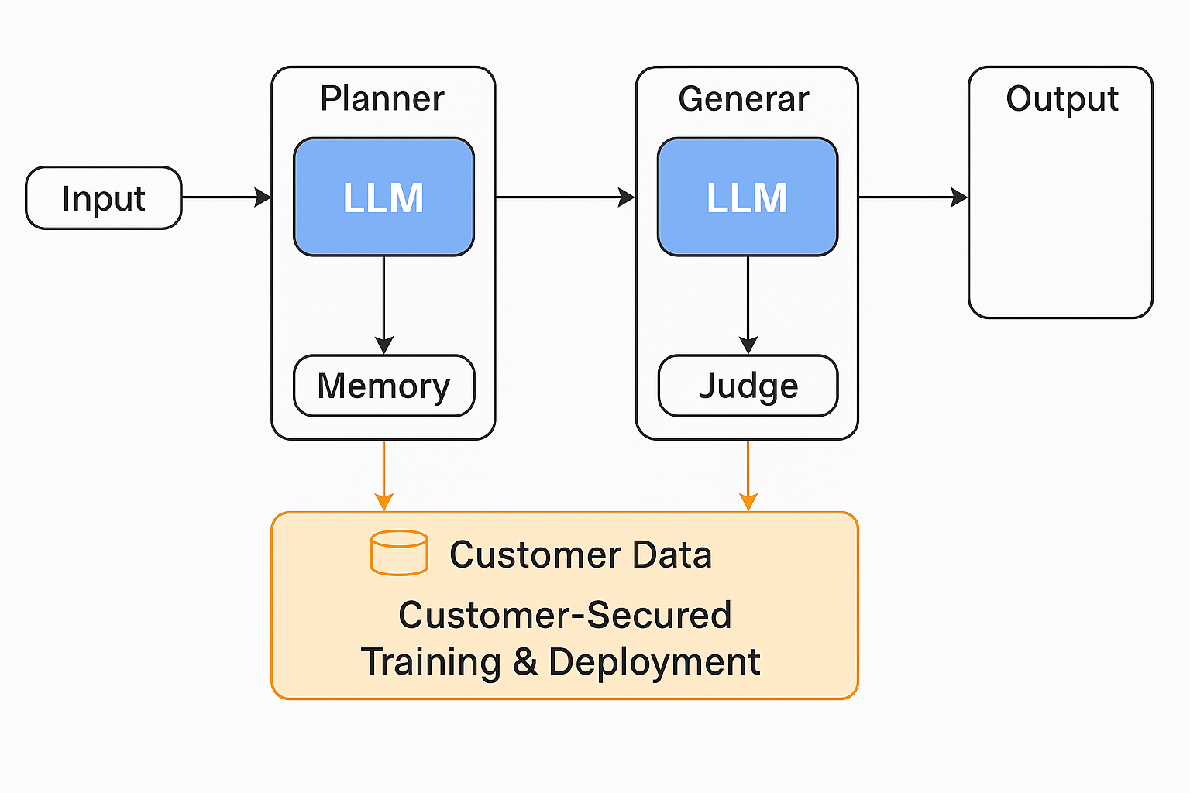
Technical Architecture —
Intelligent Agent Loop Meets MBSE
🔁 Agent Loop Architecture Planner → Generator → Judge → Memory → Simulator → Codegen
📐 MBSE Integration
Auto-generates models (Capella, MagicDraw)
Maps Sys.1 to Sys.4
Exports embedded code blocks & test coverage mappings
🧪 Simulation + Codegen Layer
Supports UML/Plant/SystemC scenarios
Links test snapshots and results to outputs
CI-ready GitOps export for traceability
🔐 Security & Audit
BYOM support (Bring Your Own Model/LLM)
Role-based access and audit logs
VPC-ready sandbox deployment

Slide 21
Built for Compliance —
IREB, ASPICE, ISO, EU AI Act
📋 Automated Compliance from Day 1
✅ IREB Checklist Enforcement
✅ ASPICE Workflow Coverage
✅ ISO 26262 Safety Mapping
✅ ISO 21434 Threat Modelling Hooks
🧠 EU AI Act Readiness
Explainability via Judge feedback
Decision trace logs
Exportable audit trails
🧾 Role-Based Compliance Reports
Document who edited what, and why
Full traceability from input to output

Slide 22
What the Output Looks Like — Structured, Traceable, Editable
🧾 Sample Outputs
Sys.1 to Sys.5: Structured and labelled
Judge comments with quality scores
UAT-aligned test cases
MBSE diagrams generated from system models
Code stubs (Rust/C++) with embedded function contracts
🎯 Every output is ready for ALM upload, audit, and reuse

Slide 23
Deployment Options — SaaS, VPC, On-Prem, Air-Gapped
🚀 Flexible Deployment Paths
GitHub Codespaces (developer access)
Hugging Face Demo (public showcase)
VPC-Hosted Pilots (OEM testing)
On-Prem or Air-Gapped for defense/regulated domains
🛠️ Roadmap Integrations
Jenkins CI Plugin
VSCode Agent Plugin
MBSE Toolchain Adapter
🌐 Native GitOps pipeline for commit/track/reuse integration

Slide 24
Join Us —
Revolutionize Engineering With AI Agents
💰 Investment Ask: $5M for 10% equity
📈 Preferred Rights: Next $5M round at higher valuation
🧠 Strategic Needs:
OEM Pilot Partners (Auto, Aero, Health)
Regulatory Advisors (ISO, EU AI Act)
Channel Partners (ALM/MBSE vendors)
🌟 Vision: Build the most trusted AI Agent system for engineering

Slide 25
Roadmap Milestones —
Sys.3 to Sys.4 and Beyond
Year | Milestone | Description
2026 | Sys.3 Generation | Extract integration & interface requirements
2027 | Sys.4 Test Case Engine | Simulation-driven integration testing
2028 | Code Synthesis | Generate Rust/C++ from validated Sys.5
2029 | HIL/SIL Loop | Closed-loop scenario refinement
2030 | Embedded Feedback | Full DevOps + telemetry learning loop
🎯 AgentX evolves from document generator → full-lifecycle DevOps automation platform

Slide 26
Platform Expansion — Aerospace, Health, Defense
🎯 New Domain Targets
Aerospace: Cert-first system design (DO-178C, MBSE driven)
Healthcare: FDA-traceable design control & testing
Defense: Sandbox BYOM agents for MILS workflows
🔁 Expansion Path
Plugin Orchestration (adaptable flows)
APIs for ALM/MBSE integration
Licensing + Agent Marketplace for partner deployment

Slide 27
Support & Deployment —
Flexible, Responsive, Scalable
🧰 Deployment Models
SaaS
VPC
On-Prem
Air-Gapped
🤖 Customer Support Architecture
5-person Deployment & DevRel Team
Custom Chatbot Agent per tenant
48h SLA, guided onboarding, escalation path
🔐 Audit Logging & Role-Based Actions
Full traceability
Regulatory exportability

Slide 28
Simulation & MBSE —
Core of the Next-Gen Agent Loop
🧠 Model-Based System Engineering (MBSE) Loop
Auto-generation: Capella, MagicDraw
Input ➝ Plant/UML Scenario ➝ Simulation ➝ Output Snapshot
🛠 Codegen Support
Formal logic ➝ function contracts (Rust/C++)
Multi-agent orchestration (separate for Gen, Judge, Memory)
🔁 GitOps + CI Loop
All simulation + MBSE artifacts committed with trace
Built-in audit for every step

Slide 29
Customer Journey — End-to-End Experience
Upload chaotic input
Planner segments
Generator proposes
Judge applies thresholds
Memory adapts
GitOps-ready export
💬 "Saved us 4 weeks + 3 reviews" — OEM Pilot

Slide 30
Demo Results — OEM Validated
Supports: PDF, Jira XML, DOCX
Gen Time: 6 min for 80+ requirements
IREB Score: 92%
Edit Reuse Accuracy: 85%+
UAT Testcase Gen: 1–2 min per cluster

Slide 31
Why AgentX Will Win
Judging Criteria | Status
Validated Need | ✅ OEM LOIs + surveys
MVP Working | ✅ GitHub + HuggingFace
Defensible Tech | ✅ Multi-agent + GitOps
Compliance/AI Fusion | ✅ IREB, ASPICE judged
Team Execution | ✅ Domain, GTM, LLM
Revenue + Impact | ✅ $10M ARR path
🌟 Let’s build the world’s most trusted AI agent platform.

Slide 32


Thank You!
About Onward Technologies
Onward Technologies (ONWARDTEC: NSE) is a software outsourcing company specializing in digital and ER&D services. We help global OEMs improve speed to market, accelerate innovation, and maximize returns on their R&D investments. Headquartered in Mumbai, India, we are also an employer of choice driving positive change as a responsible corporate citizen. With over 2800 employees across 14 offices in 6 countries and offshore development centers in India, we support multiple businesses in Transportation, Mobility, Industrial Products, Heavy Machinery and Healthcare verticals.

